Slide 1
Efficient and secure memory allocator
Presenter: Roman Astrakhantsev, CS-171
Team member: Arseny Mitin , CS-171
Scientific adviser: Alexey Nesterenko
Notes:
Good afternoon, ladies and gentlemen. My name is Roman Astrakhantsev. Today I would like to present our project “Efficient and secure memory allocator”.

Slide 2
Plan
Relevance & Goal
Use-after-free vulnerability
Existing solutions
Proposed methods
Address randomization
Split and consume strategy
Future work
2
Notes:
Here you can see the outline of presentation. I’ll briefly explain use-after-free vulnerability so that everybody understands the problem.

Slide 3
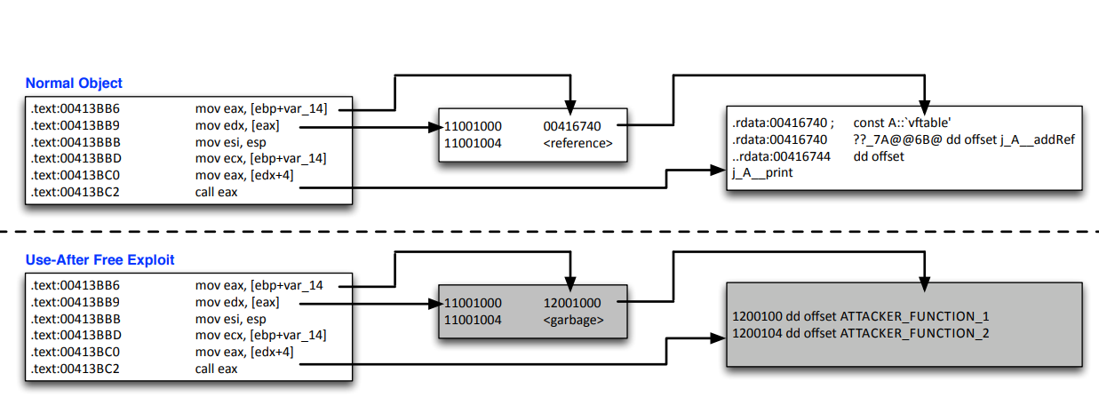
Use-after-free vulnerability
Memory Requests
Allocation
Allocation
Allocation
Deallocation
Deallocation
Allocation
Allocation
Deallocation
D. Dewey, B. Reaves, P. Traynor “Uncovering Use-After-Free Conditions in Compiled Code”, 2015
3
Notes:
OK. Let’s get started.
In a nutshell, there are some programs that interact with both user input and dynamic memory storage.
Such interaction may cause unintended behavior depending on request chain. As presented on the slide the usage of the same code may lead to exploitation depending on the memory requests.
This vulnerability is called use-after-free.

Slide 4
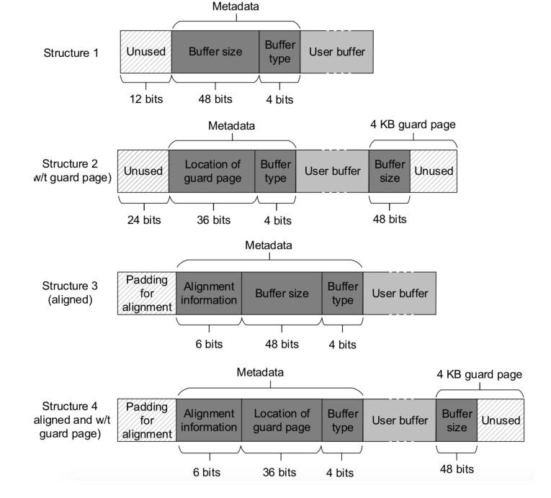
Existing solutions
Q. Zeng, G. Kayas, E. Mohammed, L. Luo, X. Du, J. Rhee “HeapTherapy+: Efficient Handling of (Almost) All Heap Vulner-abilities Using Targeted Calling-Context Encoding”, 2019
4
Notes:
It is important to highlight the existing solutions and their drawback, before formulating the goal. Metadata structures of different allocators are presented on the slide. It can be seen that some fields are redundant while others are unused. With all that in mind we can formulate the goal. There is a need in secure AND efficient memory allocator.

Slide 5
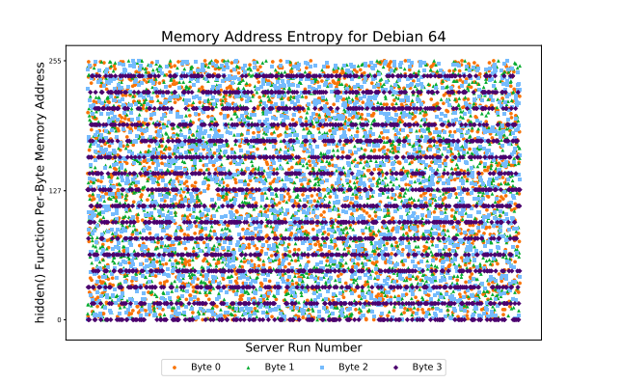
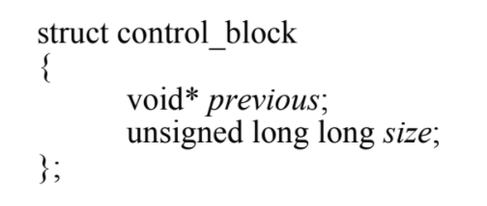
Address randomization
J. Ganz, S. Peisert “ASLR: How Robust Is the Randomness?”, 2017
5
Notes:
Now I’d like to tell you what methods we considered to be appropriate to achieve these goals.
One of them is address randomization. It should be mentioned that exploits, which are based on use-after-free vulnerability, uses address prediction technique. It means that if we can somehow disable such predictions, we will be protected from this kind of attack.
You can see the entropy of randomized memory addresses that was produced by Debian 64 allocator.
The final algorithm needs to place allocated block in the memory space randomly.
By the way, on the left side you can see our metadata which are represented in terms of C language. We named this structure “memory control block”.

Slide 6
Split and consume strategy
MCB
USER DATA
NOT USED
MCB
NOT USED
MCB
NOT USED
SPLIT
CONSUME
MCB
USER DATA
MCB
NOT USED
MCB
NOT USED
6
Notes:
The next method I’d like to mention is split and consume strategy.
Let me explain with a concrete examples.
It is possible to split a MCB that holds user data and have enough capacity in order to save memory.
From the other point of view, two unused and adjacent memory chunks can me merged together.
The combination of this 2 techniques is named split and consume strategy.

Slide 7
Results
Secure & efficient memory allocator
sizeof(MemoryControlBlock) == 4
Automated building process
Documented source code and building process
Test coverage
7
Notes:
So, what results did we manage to obtain with the help of these methods?
The secure and efficient memory allocator, of course! It can protect from attacks like “use-after-free”, using only 64 bits of additional metadata without unused space.

Slide 8
Future work
Multithread perspective
Efficiency measurement
Comparison with other allocators
Vulnerable container & Proof of work
8
Notes:
Nevertheless, there are still some points that can be improved in our implementation.
First of all, we haven’t tested our memory manager in a multithread applications.
We also haven’t measured the time spend on average allocation and haven’t compare the results with other allocators.
And the last point of further research can be creation of vulnerable docker container to represent the protection in action.

Slide 9

github.com/hse-malloc/malloc
9
Notes:
That brings me to the end of my presentation.
Here you can see the link to our source code on github.

Slide 10
References
Q. Zeng, G. Kayas, E. Mohammed, L. Luo, X. Du, J. Rhee “HeapTherapy+: Efficient Handling of (Almost) All Heap Vulnerabilities Using Targeted Calling-Context Encoding” // 49th Annual IEEE/IFIP International Conference on Dependable Systems and Networks (DSN), 2019
B. Liu, P. Olivier, B. Ravindran “SlimGuard: A Secure and Memory-Efficient Heap Allocator” // Middleware '19: Proceedings of the 20th International Middleware Conference, 2019
J. Ganz, S. Peisert “ASLR: How Robust Is the Randomness?” // IEEE Cybersecurity Development (SecDev), 2017
D. Dewey, B. Reaves, P. Traynor “Uncovering Use-After-Free Conditions in Compiled Code” // International Conference on Availability, Reliability and Security, ARES, 2015
N. Zlatanov “Dynamic Memory Allocation and Fragmentation” // ESC, 2015
M. Masmano U, I. Ripoll, A. Crespo, J. Real “TLSF: A new dynamic memory allocator for real-time systems” // Proceedings. 16th Euromicro Conference on Real-Time Systems, 2004
M. S. Johnstone, P. R. Wilson “The Memory Fragmentation Problem: Solved?” // ACM SIGPLAN Notices, 1998
P. R. Wilson, M. S. Johnstone, M. Neely, D. Boles “Dynamic Storage Allocation A Survey and Critical Review” // International Workshop on Memory Management, 1995
10
Notes:
And here you can see the reference list.
Thank you for your attention! I’ll be glad to answer your questions.

